Slide 1
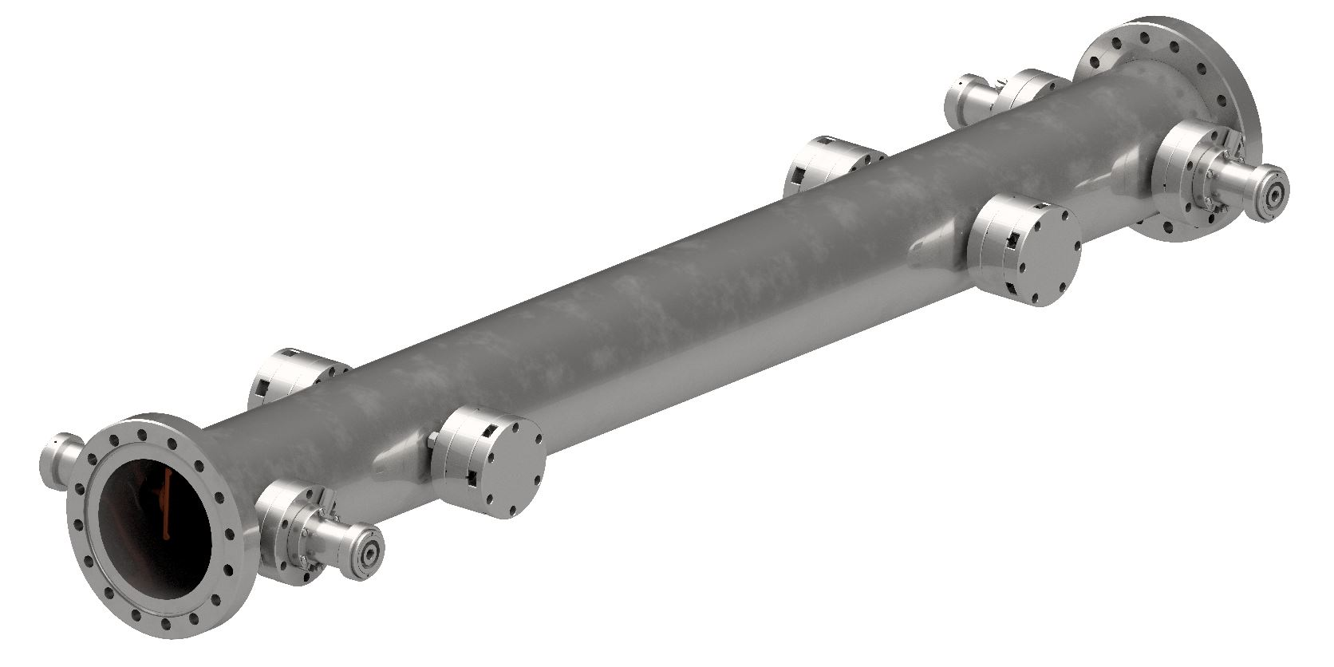
Stripline Kicker 08-17-2017

Slide 2
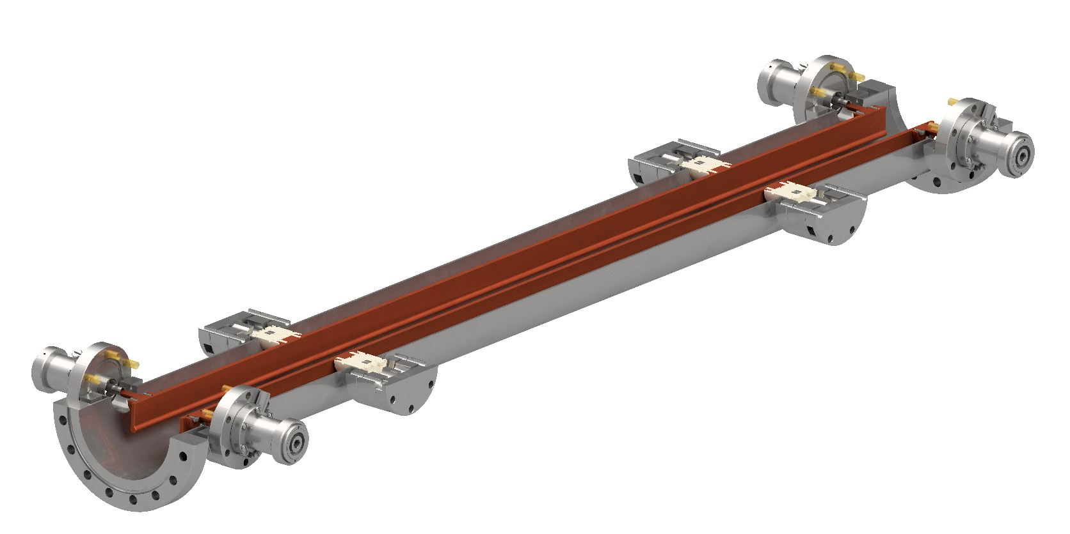
Stripline Kicker 08-17-2017

Slide 3
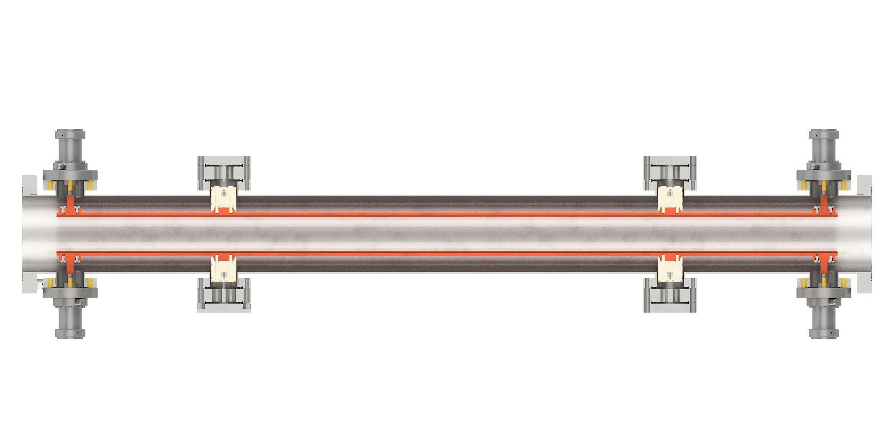
Stripline Kicker 08-17-2017

Slide 4
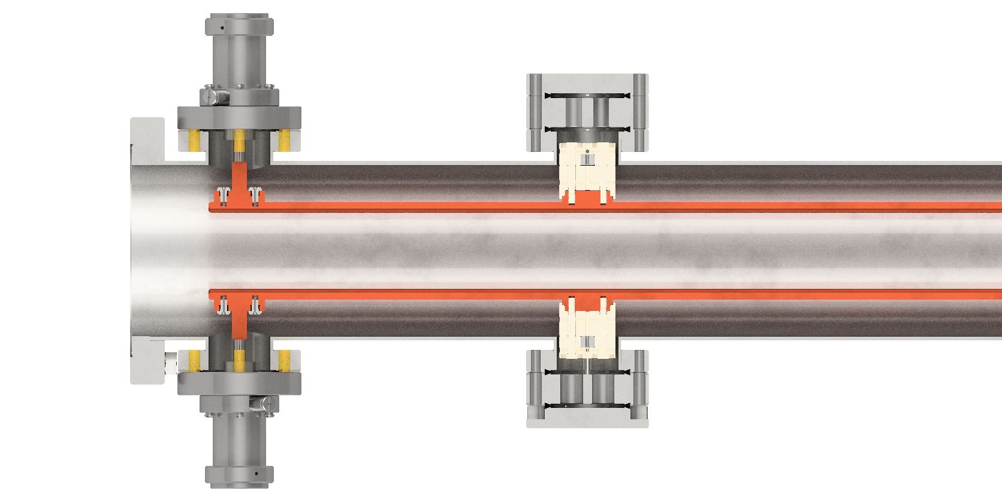
Stripline Kicker 08-17-2017

Slide 5
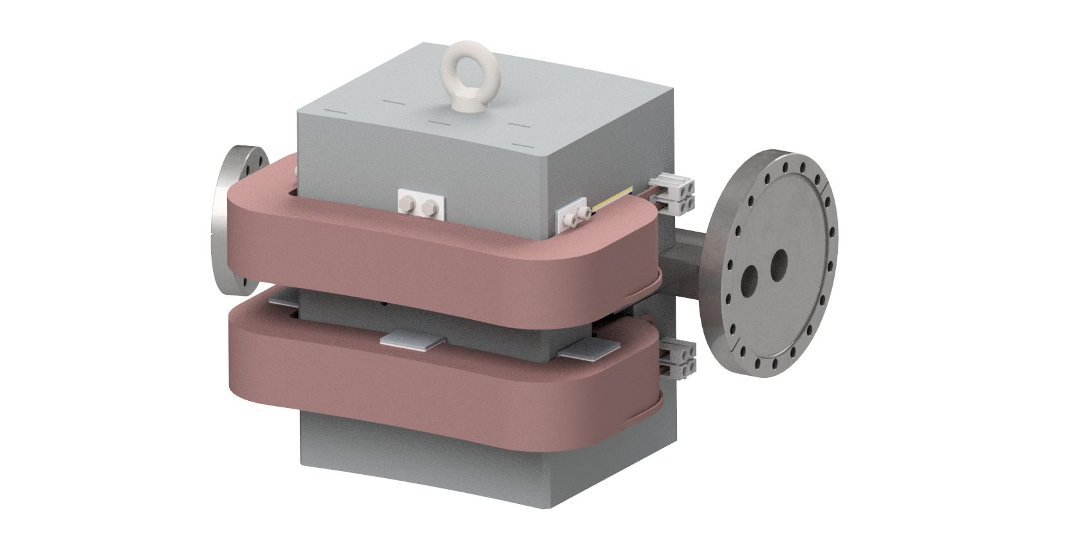
Stripline Kicker 08-17-2017

Slide 6
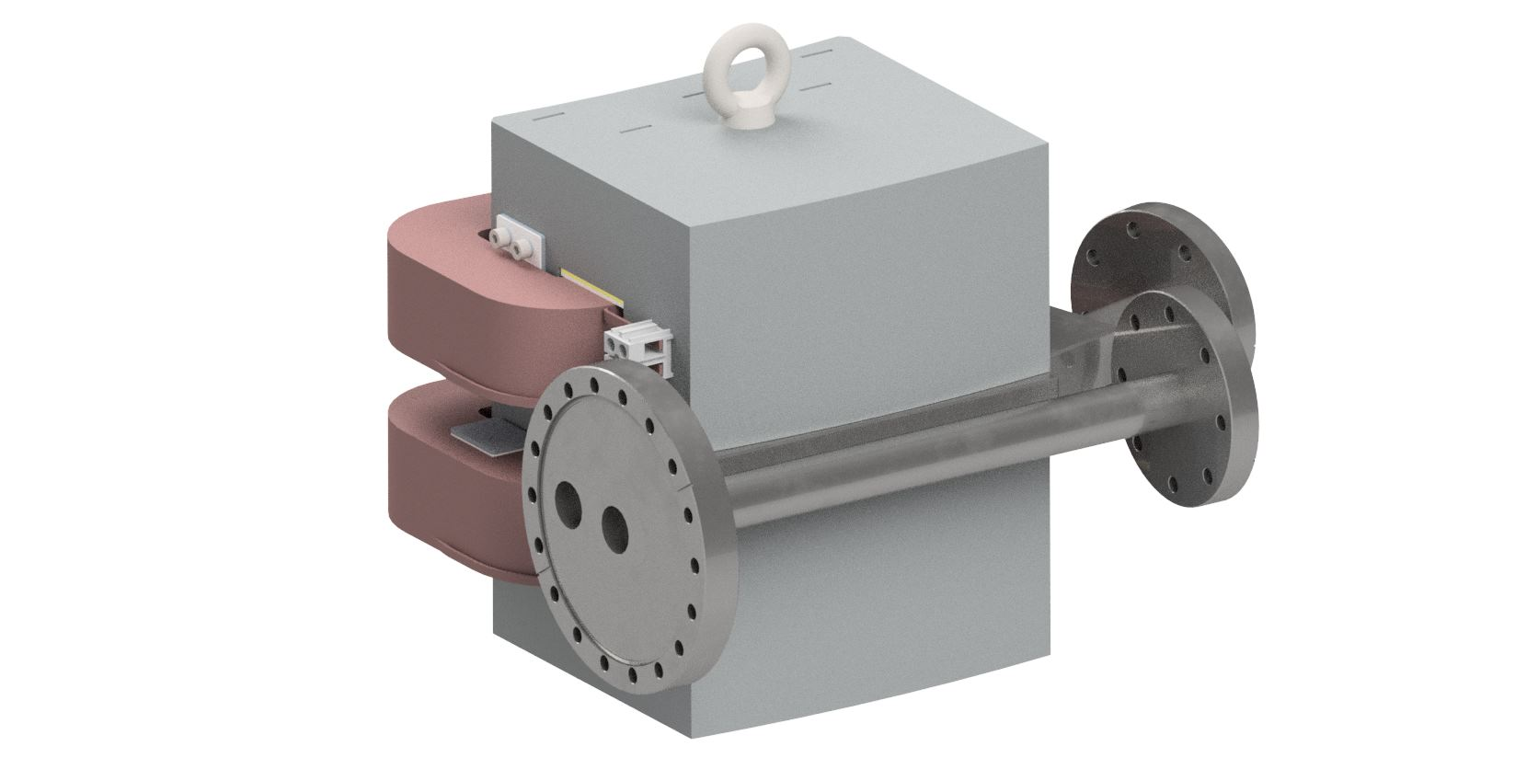
Stripline Kicker 08-17-2017

Slide 7
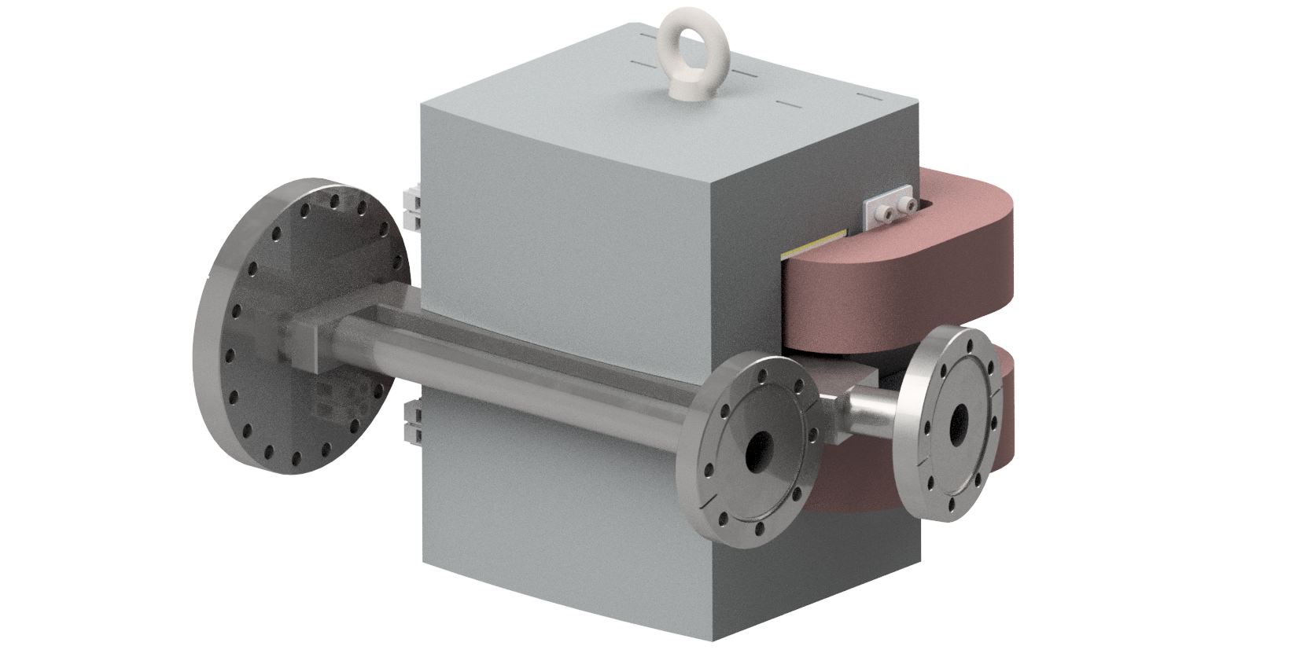
Stripline Kicker 08-17-2017

Slide 8
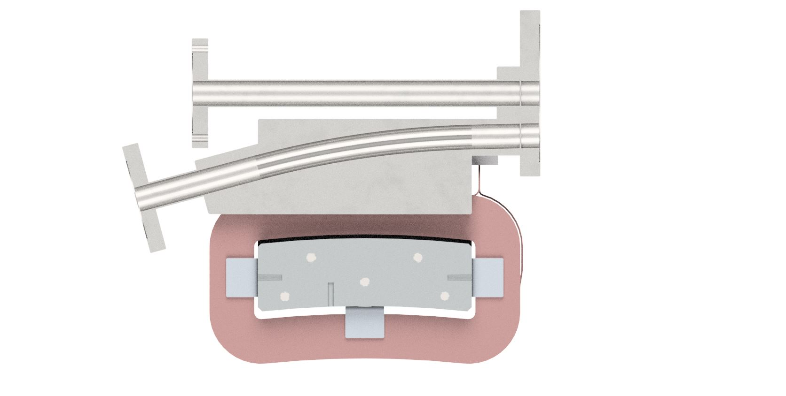
Stripline Kicker 08-17-2017

Slide 9
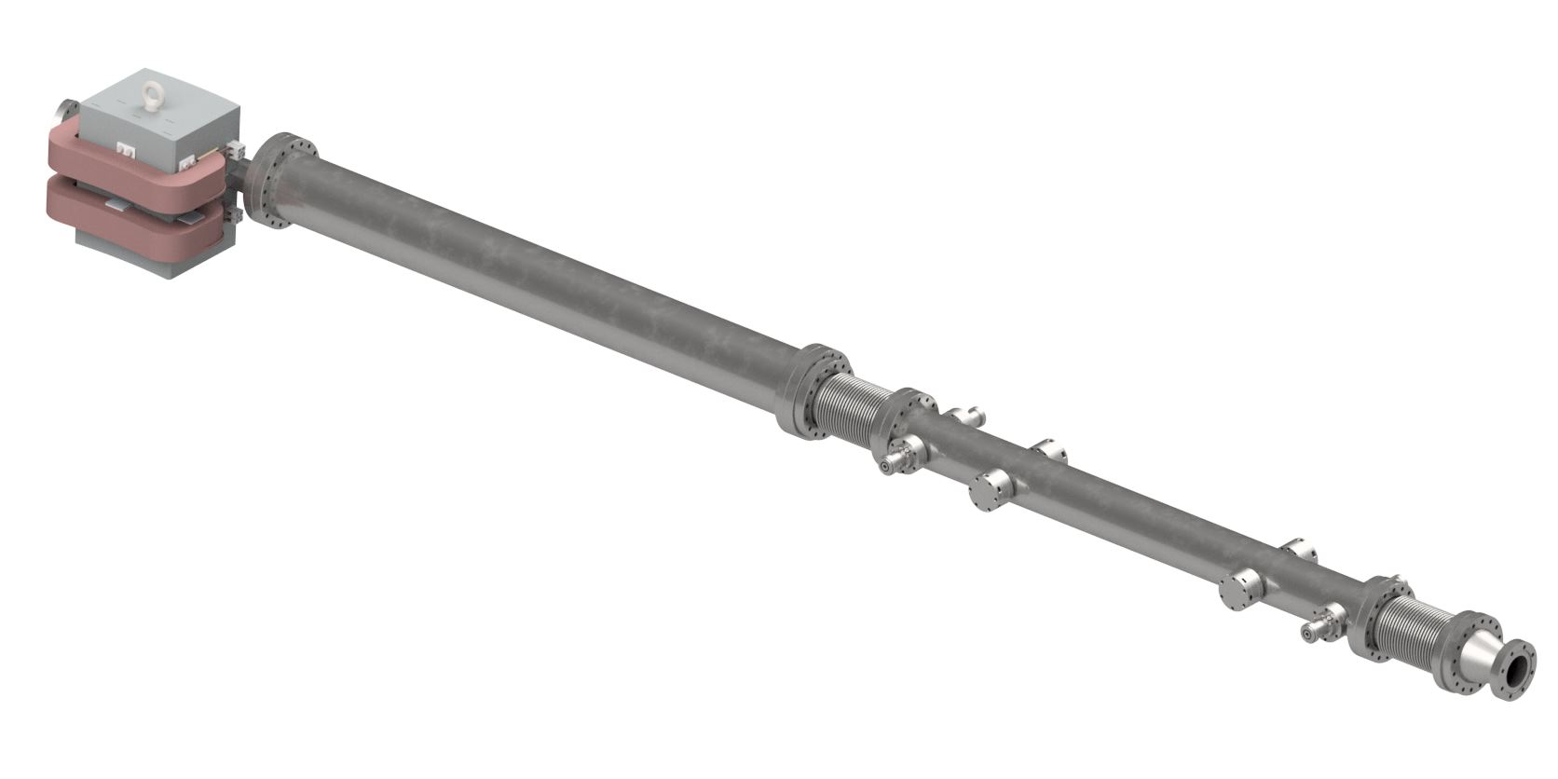
Stripline Kicker 08-17-2017

Slide 10
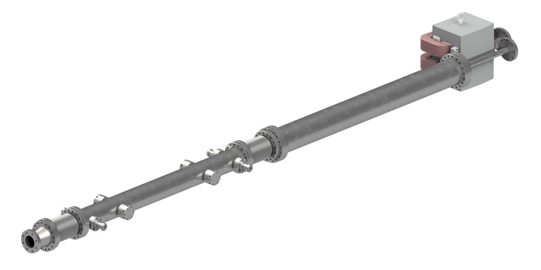
Stripline Kicker 08-17-2017

Slide 11
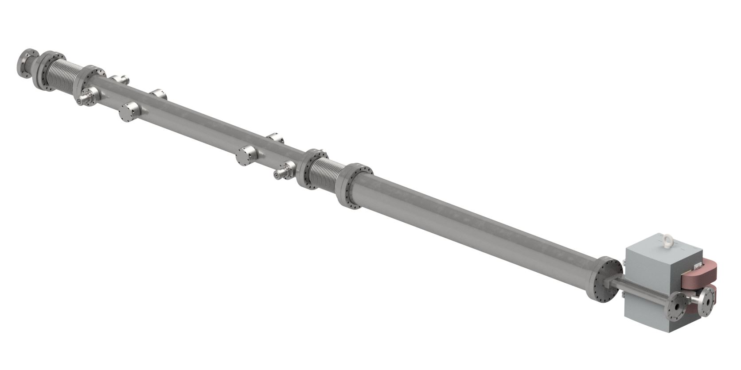
Stripline Kicker 08-17-2017

Slide 12
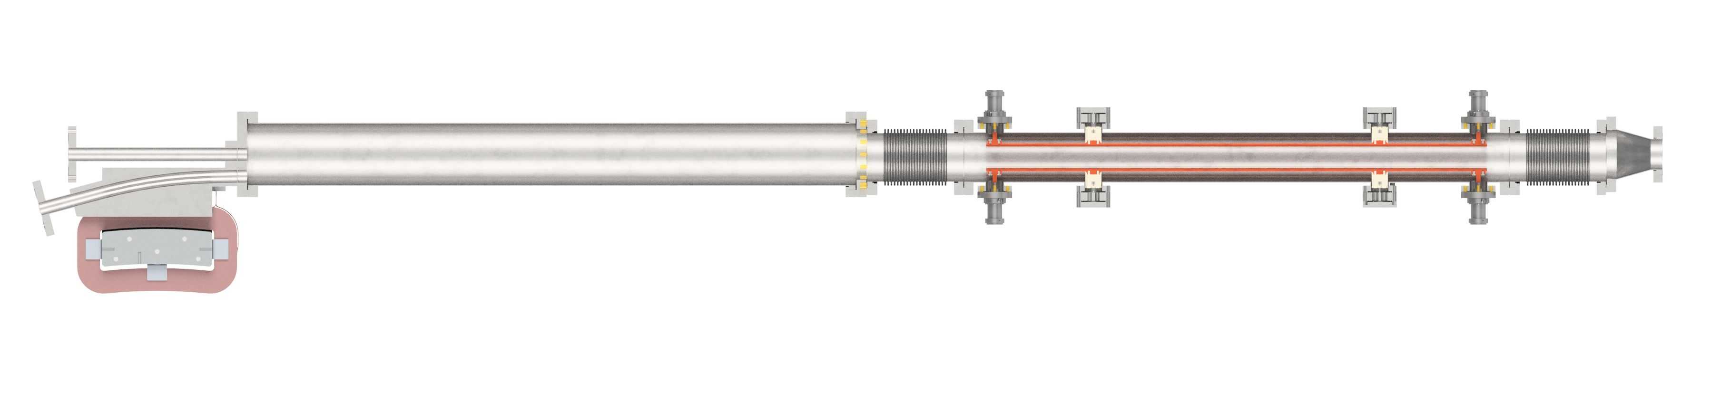
Stripline Kicker 08-17-2017

Slide 13
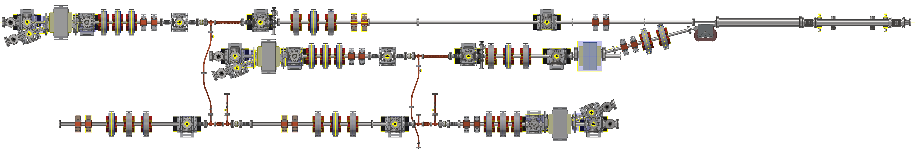
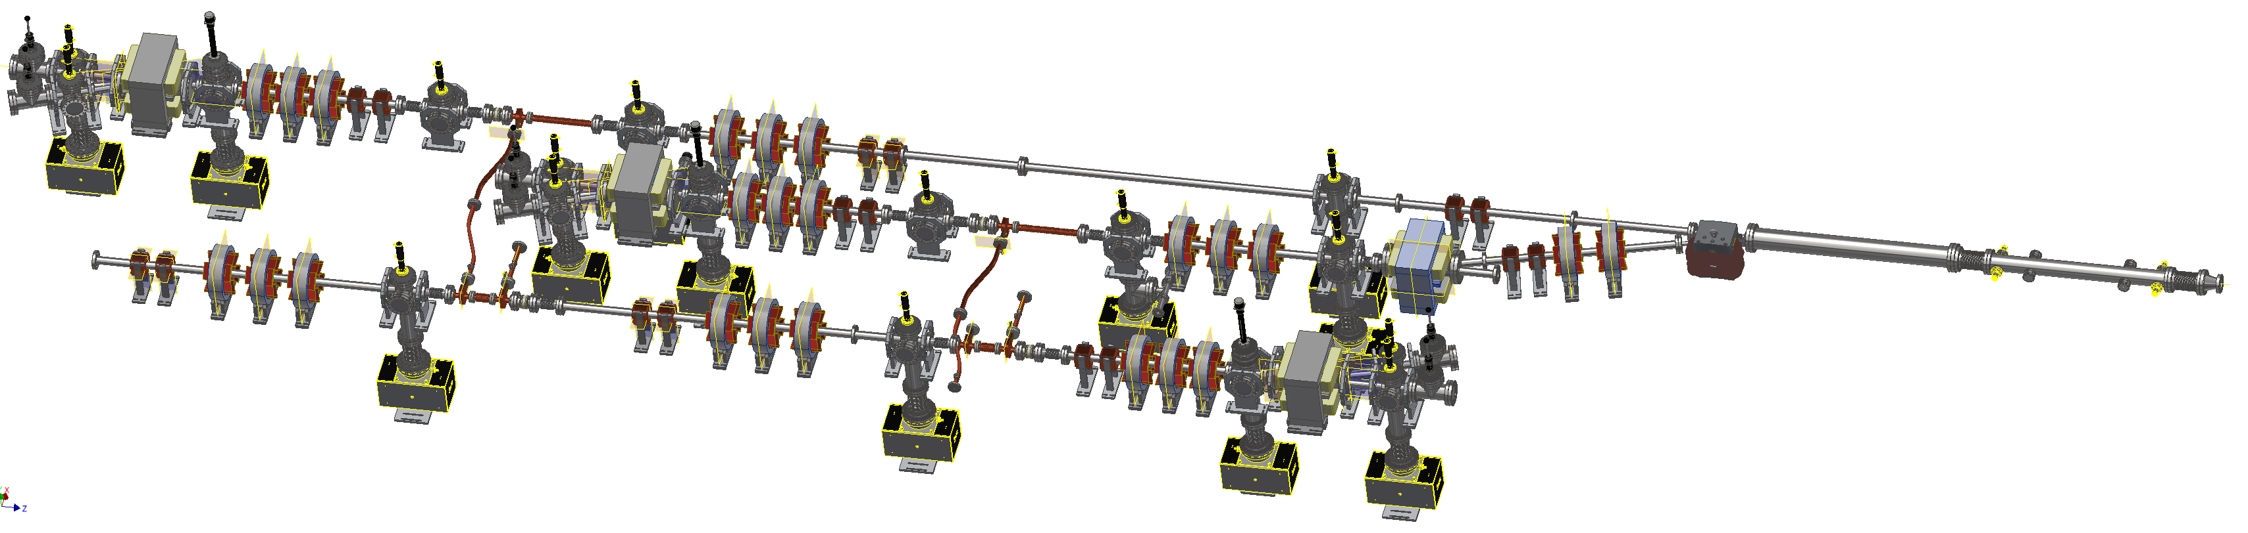
Stripline Kicker Beamline 08-17-2017

Slide 14
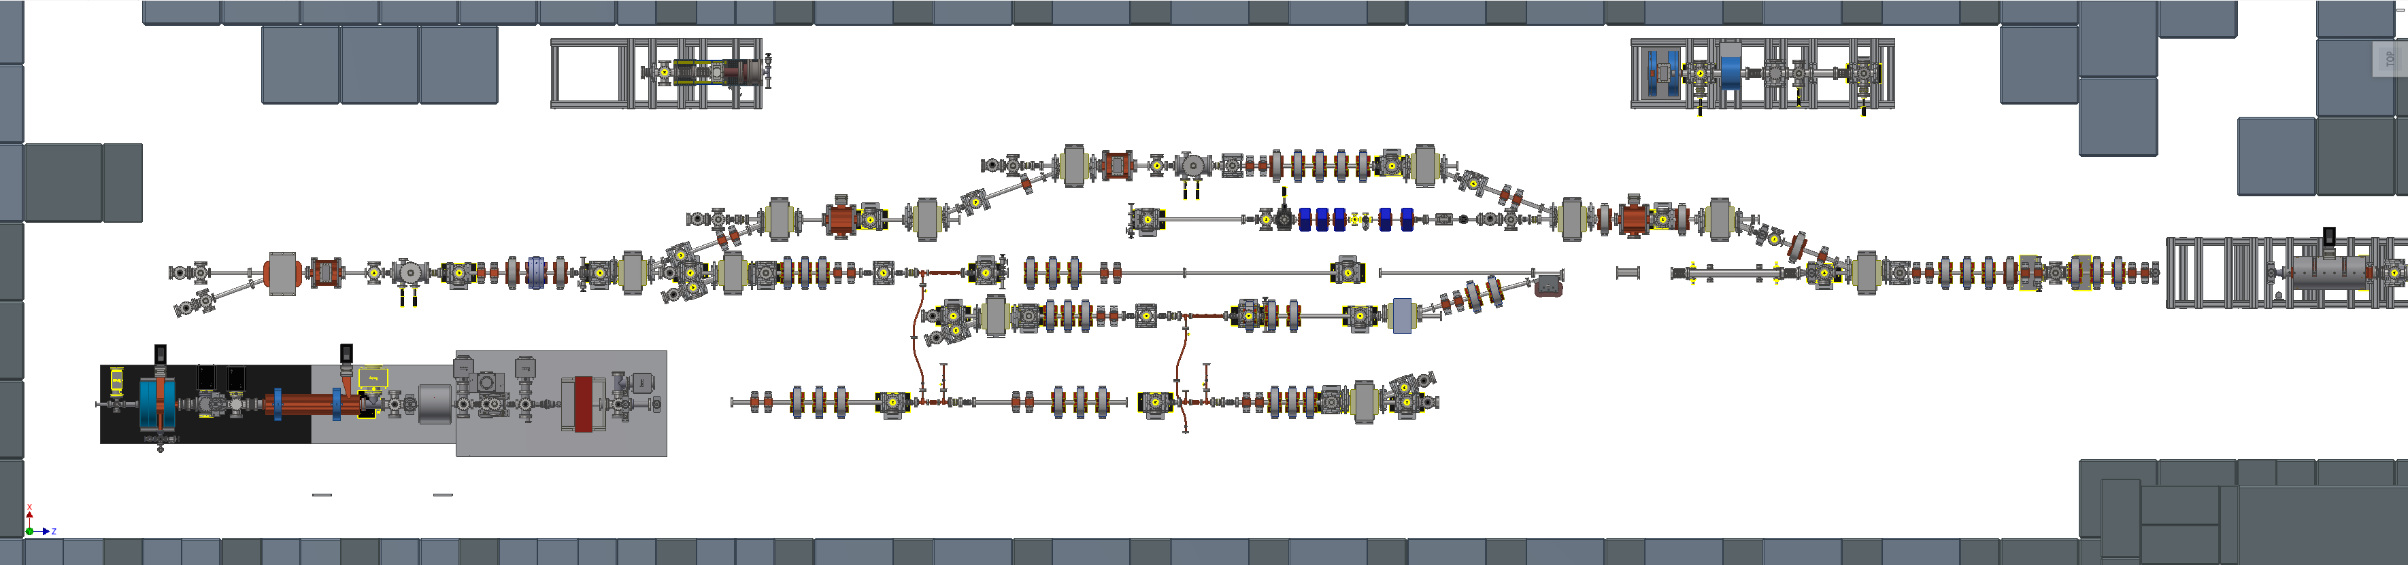
Stripline Kicker Beamline 08-17-2017

